Slide 1
12- While Loops

Slide 2
for loops to iterate over iterable objects.

Slide 3
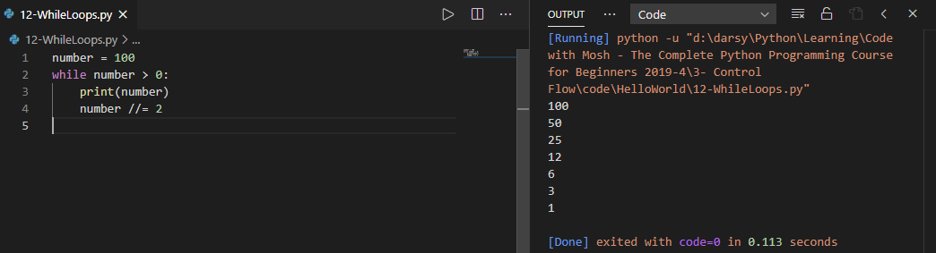
While loop:
we use that to repeat something as long as a condition is true.
Once again we have indentation so we can repeat one or more statements.
we are not iterating over an iterable like a range object or a string or a list. We are evaluating a condition and repeating a task.

Slide 4
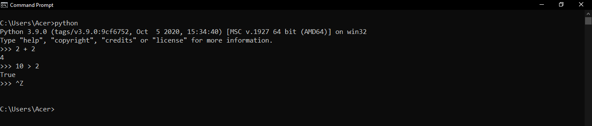
A real world example of a while loop
In this interactive shell Python is waiting for an input.
these steps will continue until repress control D So behind the scene we have a while loop that continuous execution until we press control D. That is the condition that causes the while loop to terminate

Slide 5

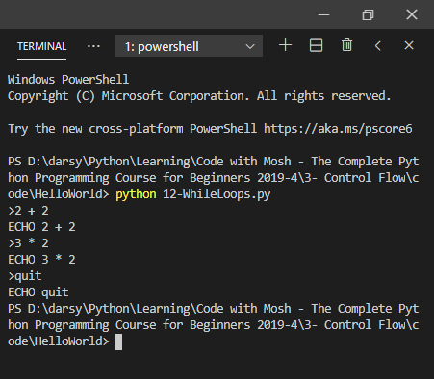
As I told you before, don't run this program using the code Runner extension. because by default it will run your program in the output window which is read only
open up a terminal using control and back tick

Slide 6
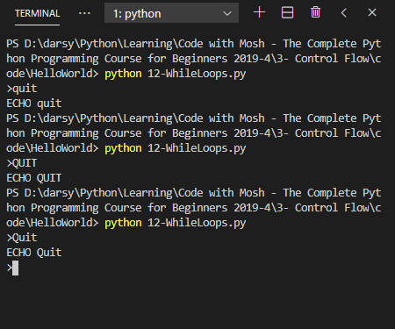

Amateur programmer:

Slide 7

Better way

